Slide 1
1. Connect
2. Git
3. Docker
4. Kubernetes
5. CI/CD
6. Misc

Slide 2

Who are you ?
Short introduction with :
- Your name
- Where do you work
- Experience with :
Git
Docker/Containers
Kubernetes
CI/CD Pipelines

Slide 3
Enviroment
For the workshop
One VM (ec2) for each Student.
One Kubernetes cluster (Single Host)
Dedicated subnet (10.0.1.0/24)
Users are : ubuntu
All Passwords are : VMware1!
All work will be done with VSCode as the client.
Remember to change directory, when you switch task.
Remember to commit / push after ending each task.
Everything you see and work on, in this workshop, is yours when you leave.

Slide 4
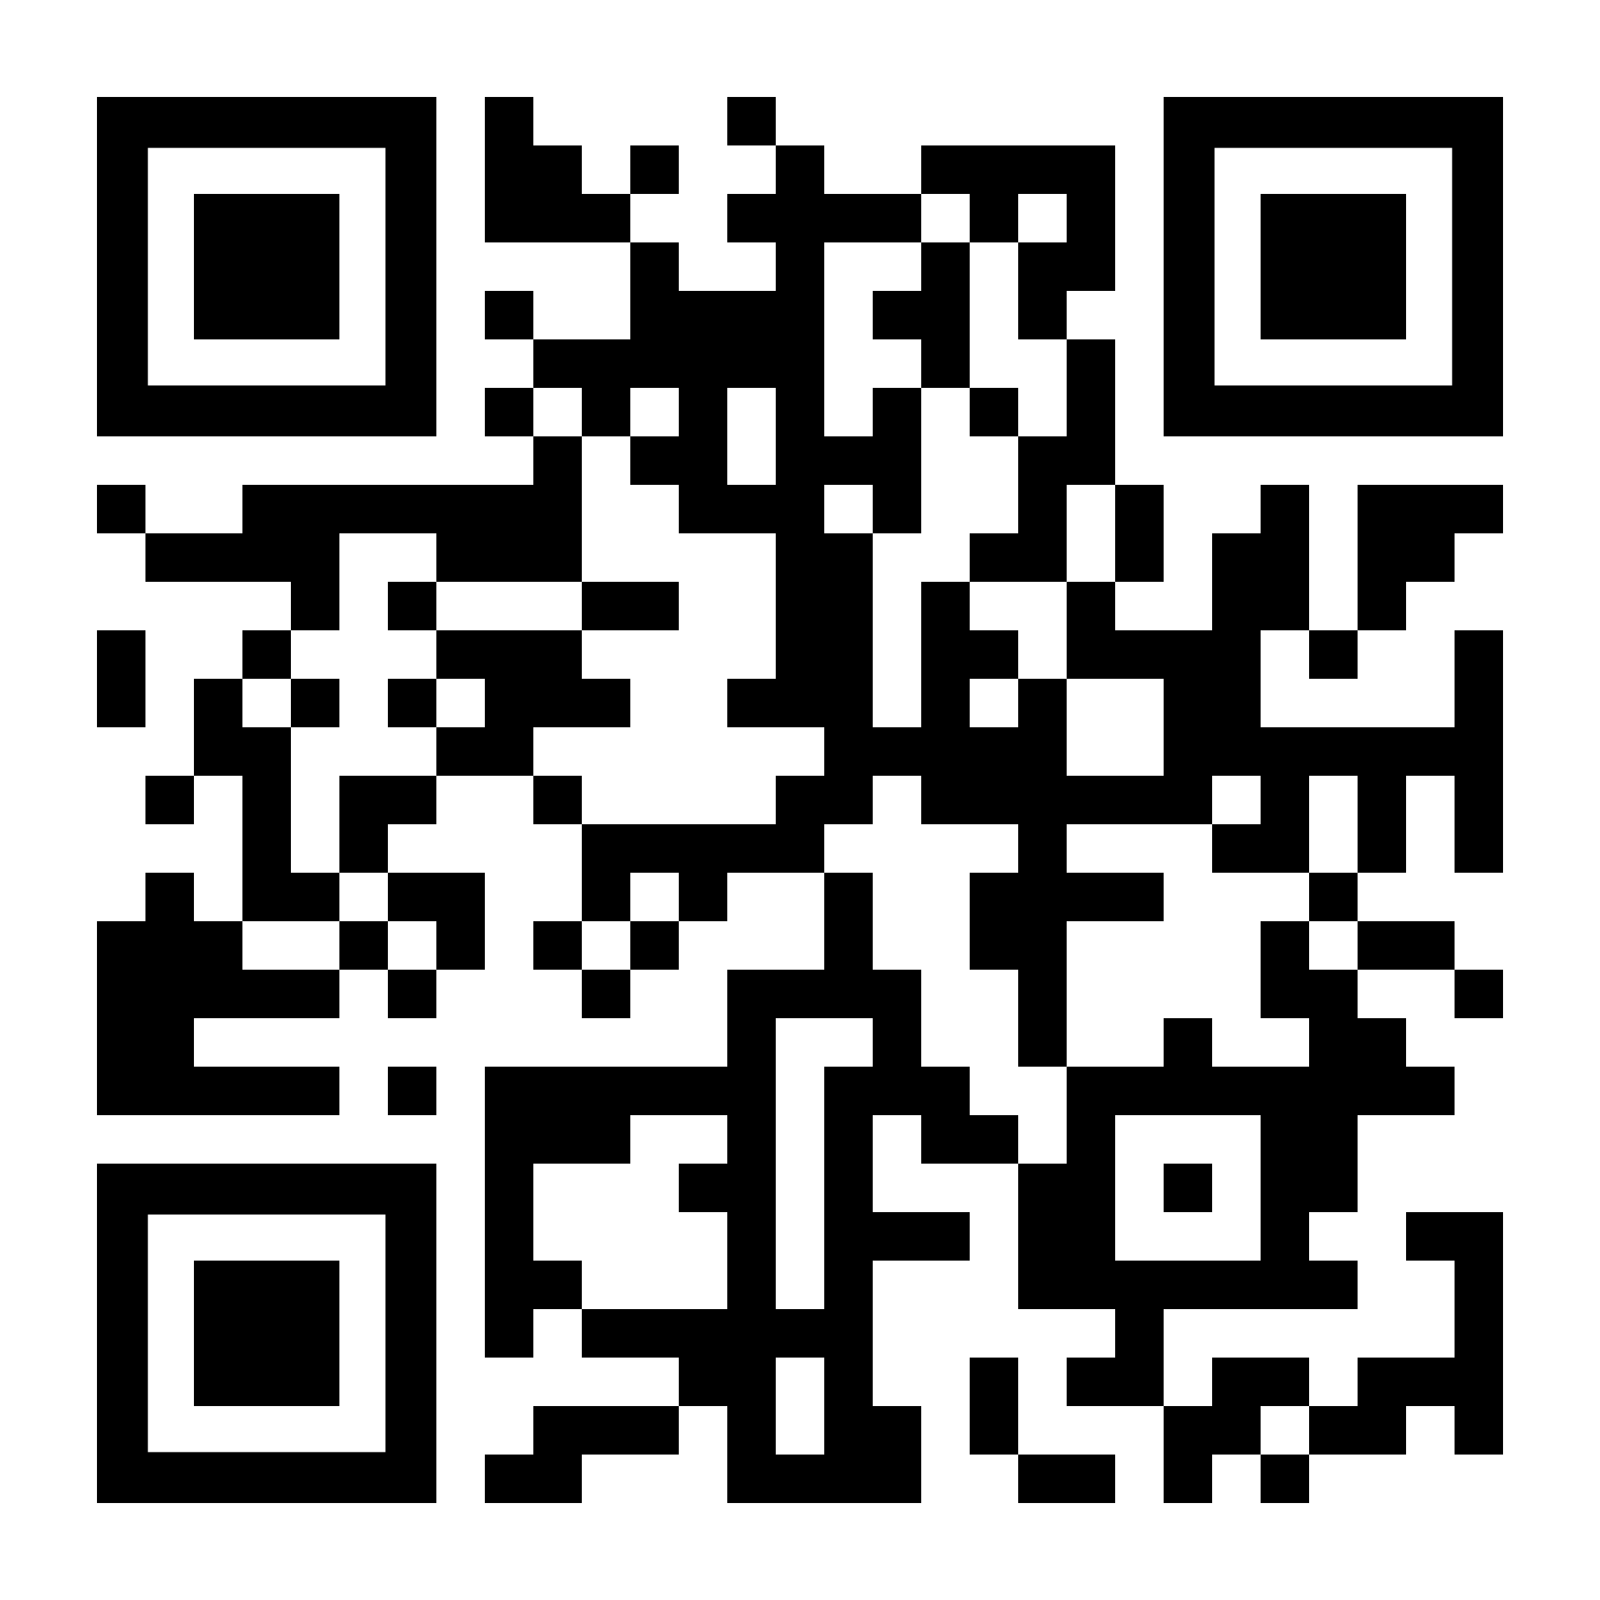
Connect
To the Github Repo
shorturl.at/zMO89
or
Log into github.com
Search for tanzudk/ops2devops
And
Open folder 1.Connect

Slide 5
1. Connect
2. Git
3. Docker
4. Kubernetes
5. CI/CD
6. Misc

